Slide 1
Threads and Concurrency

Slide 2
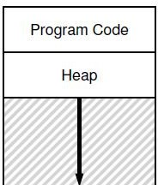

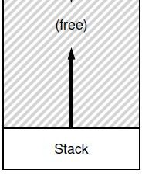
Single threaded process
So, far we have studied single threaded programs
Recap: process execution
PC points to current instruction being run
SP points to stack frame of current function call
A program can also have multiple threads of execution
What is a thread?
PC
SP

Slide 3
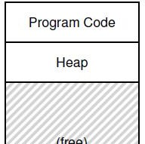
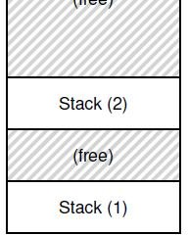
Multi threaded process
A thread is like another copy
of a process that executes independently
Threads shares the same address space (code, heap)
Each thread has separate PC
– Each thread may run over different part of the program
Each thread has separate stack for independent function calls
PC1
PC2
SP2
SP1

Slide 4

Process vs. threads
Parent P forks a child C
P and C do not share any memory
Need complicated IPC mechanisms to communicate
Extra copies of code, data in memory
Parent P executes two threads T1 and T2
T1 and T2 share parts of the address space
Global variables can be used for communication
Smaller memory footprint
Threads are like separate processes, except they share the same address space

Slide 5
Why threads?
Parallelism: a single process can effectively utilize multiple CPU cores
Understand the difference between concurrency and parallelism
Concurrency: running multiple threads/processes at the same time, even on single CPU core, by interleaving their executions
Parallelism: running multiple threads/processes in parallel over different CPU cores
Even if no parallelism, concurrency of threads ensures effective use of CPU when one of the threads blocks (e.g., for I/O)

Slide 6
Scheduling threads
OS schedules threads that are ready to run independently, much like processes
The context of a thread (PC, registers) is saved into/restored from thread control block (TCB)
– Every PCB has one or more linked TCBs
Threads that are scheduled independently by kernel
are called kernel threads
– E.g., Linux pthreads are kernel threads
6

Slide 7
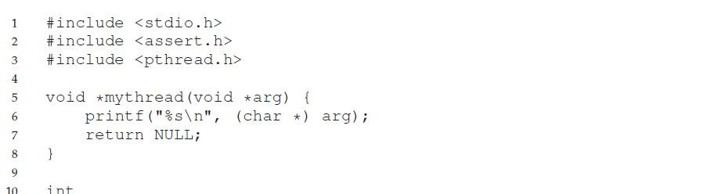
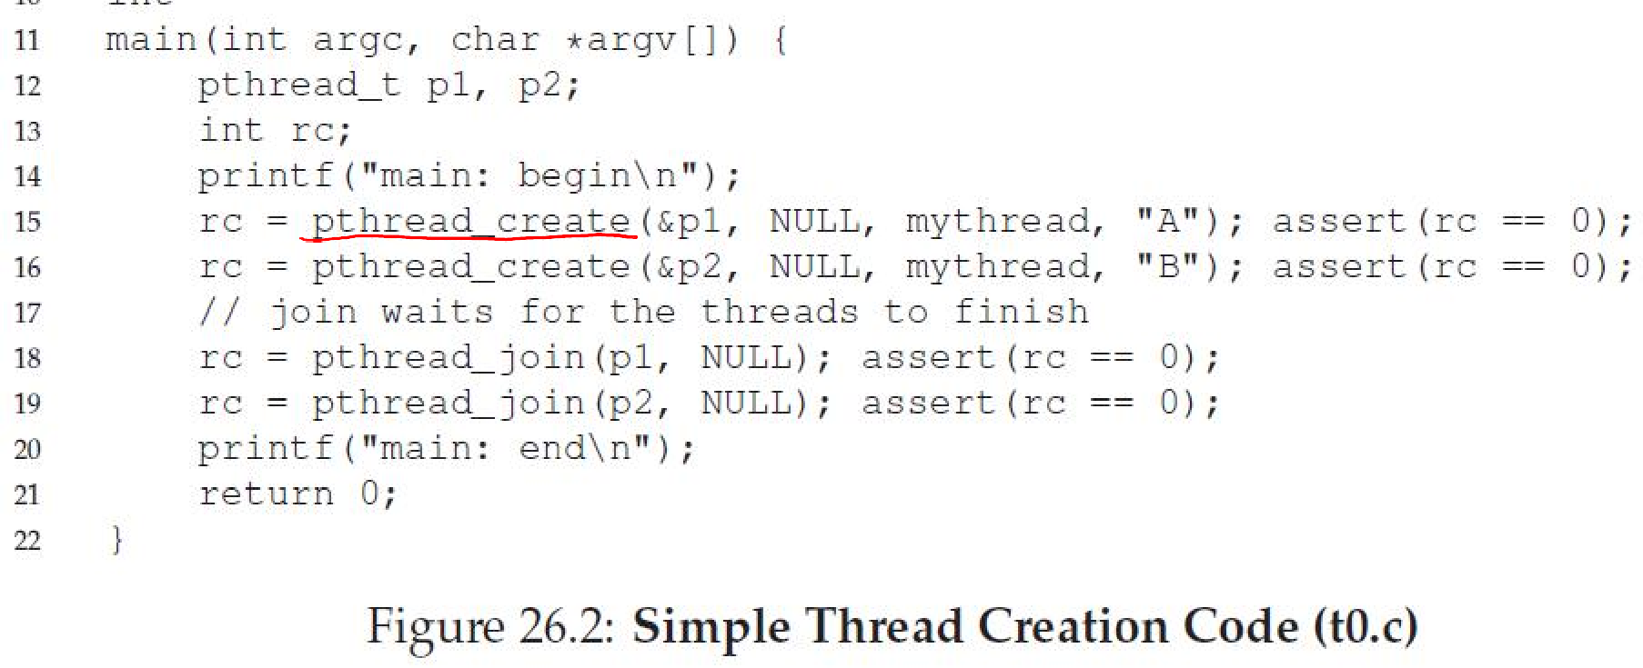
Creating threads using pthreads API
• A
7

Slide 8
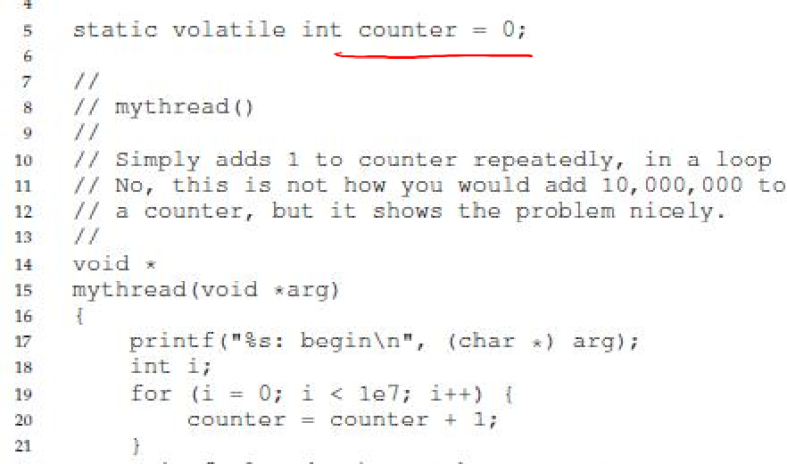
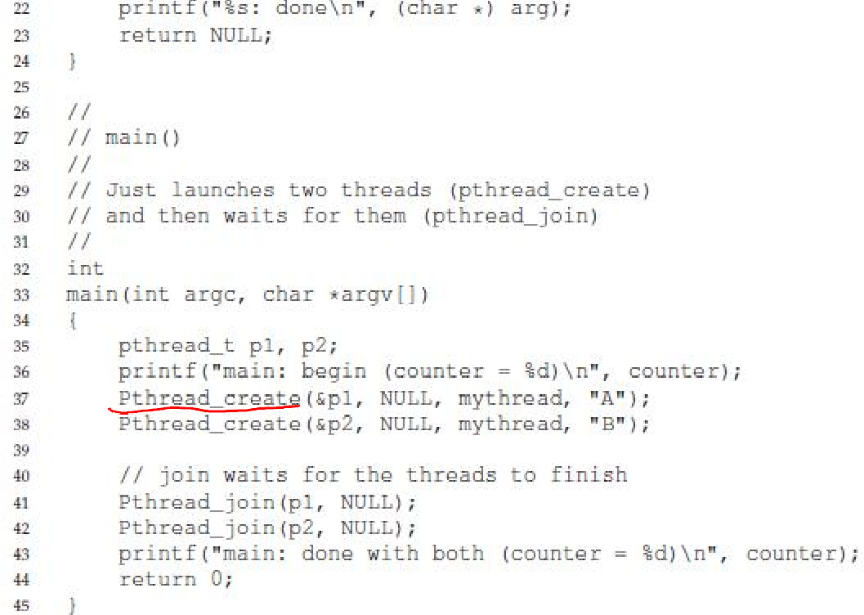
Example: threads with shared data

Slide 9

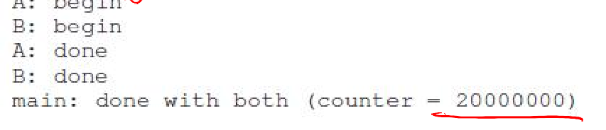
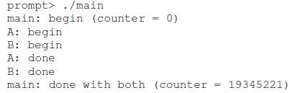
Threads with shared data: what happens?
What do we expect? Two threads, each increments counter by 10^7, so 2X10^7
Sometimes, a lower value. Why?

Slide 10


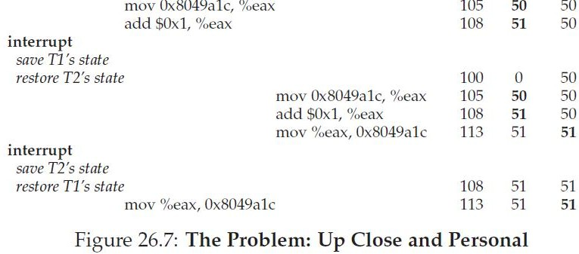
What is happening?
Assembly code of
counter = counter + 1
10

Slide 11

Race conditions and synchronization
What just happened is called a race condition
Concurrent execution can lead to different results
Critical section: portion of code that can lead to race conditions
What we need: mutual exclusion
Only one thread should be executing critical section at any time
What we need: atomicity of the critical section
The critical section should execute like one uninterruptible instruction
How is it achieved? Locks
11

